Slide 1
Redux Intro.
QiangZhou

Slide 2





What is Redux?
A Predictable State Container for JS Apps
Predictable
Centralized
Debuggable
Flexible

Slide 3
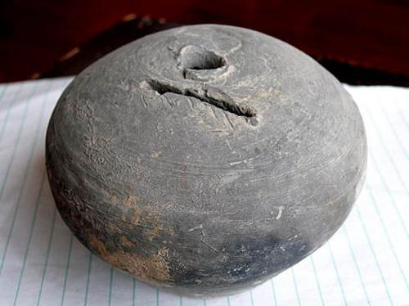
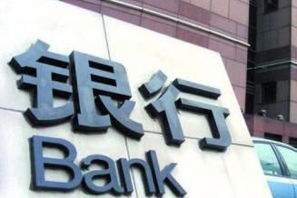
Redux is fix what?
VS
Security
Independent
Effective
Standard flow
React doesn’t provide a way to store state
Notes:
将钱存到自己家中和存到银行的 区别：存到自己家（扑满）中可能出现丢失的情况，但是可以随取随用，存到银行不会出现丢失的情况，但是要按照一定的存取钱流程进行操作。古时候的小偷都被叫做“梁上君子”

Slide 4

Architecture
How to implement this need?
Pub-Sub pattern(event-sourcing& CQRS)
Observer pattern
Reactive Programming (Rx-Programming)
…
Notes:
发布订阅模式：类似收听广播
观察者模式：定义对象间的一种一对多的依赖关系,当一个对象的状态发生改变时, 所有依赖于它的对象都得到通知并被自动更新。
响应式编程：行为由被动变成主动，当某一条件满足时，对应行为会自动执行，类比只能家电（当回家时，灯具自动开启）

Slide 5
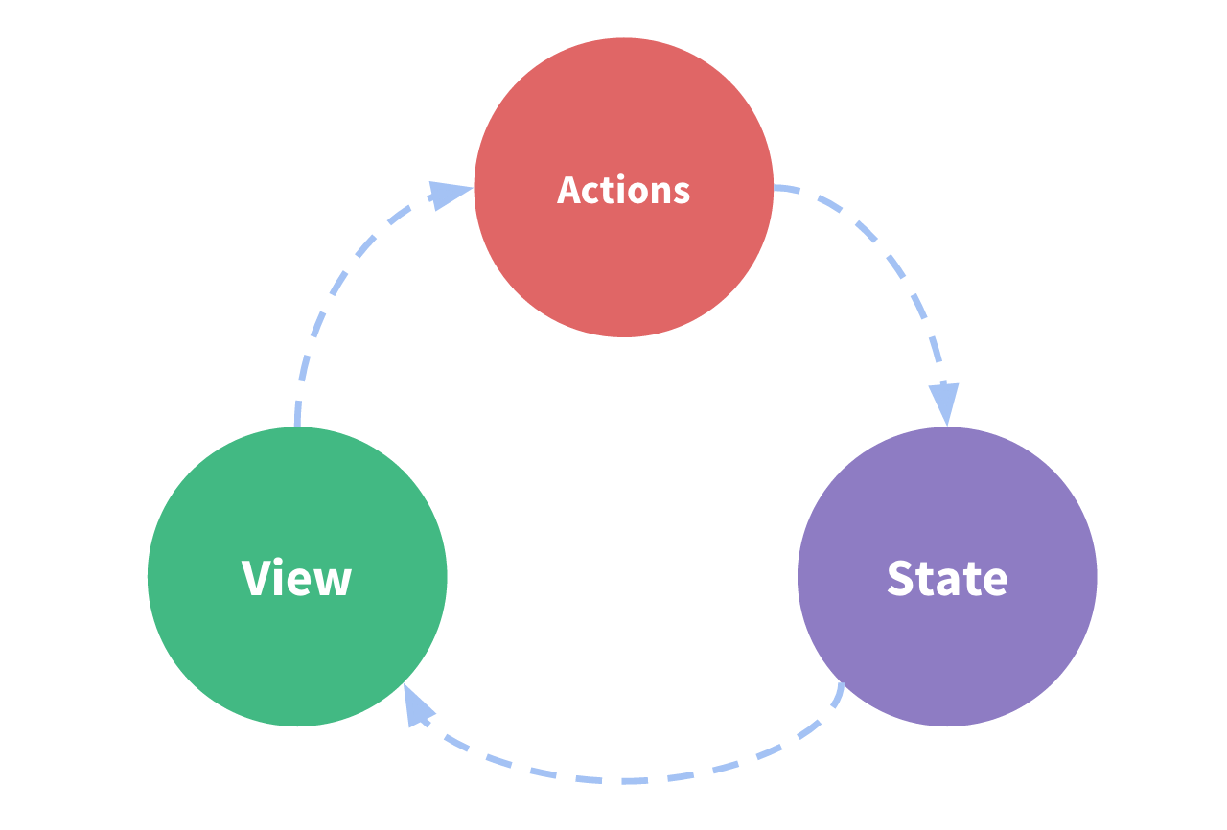
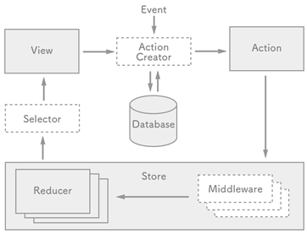
Concept

Slide 6
Concept
Principles
Single source of truth(only comes from the single store)
State is read-only(can not modify.)
Changes are made with pure functions
Flow
Binding with one way
Actions
Reducers
Store
Selectors

Slide 7
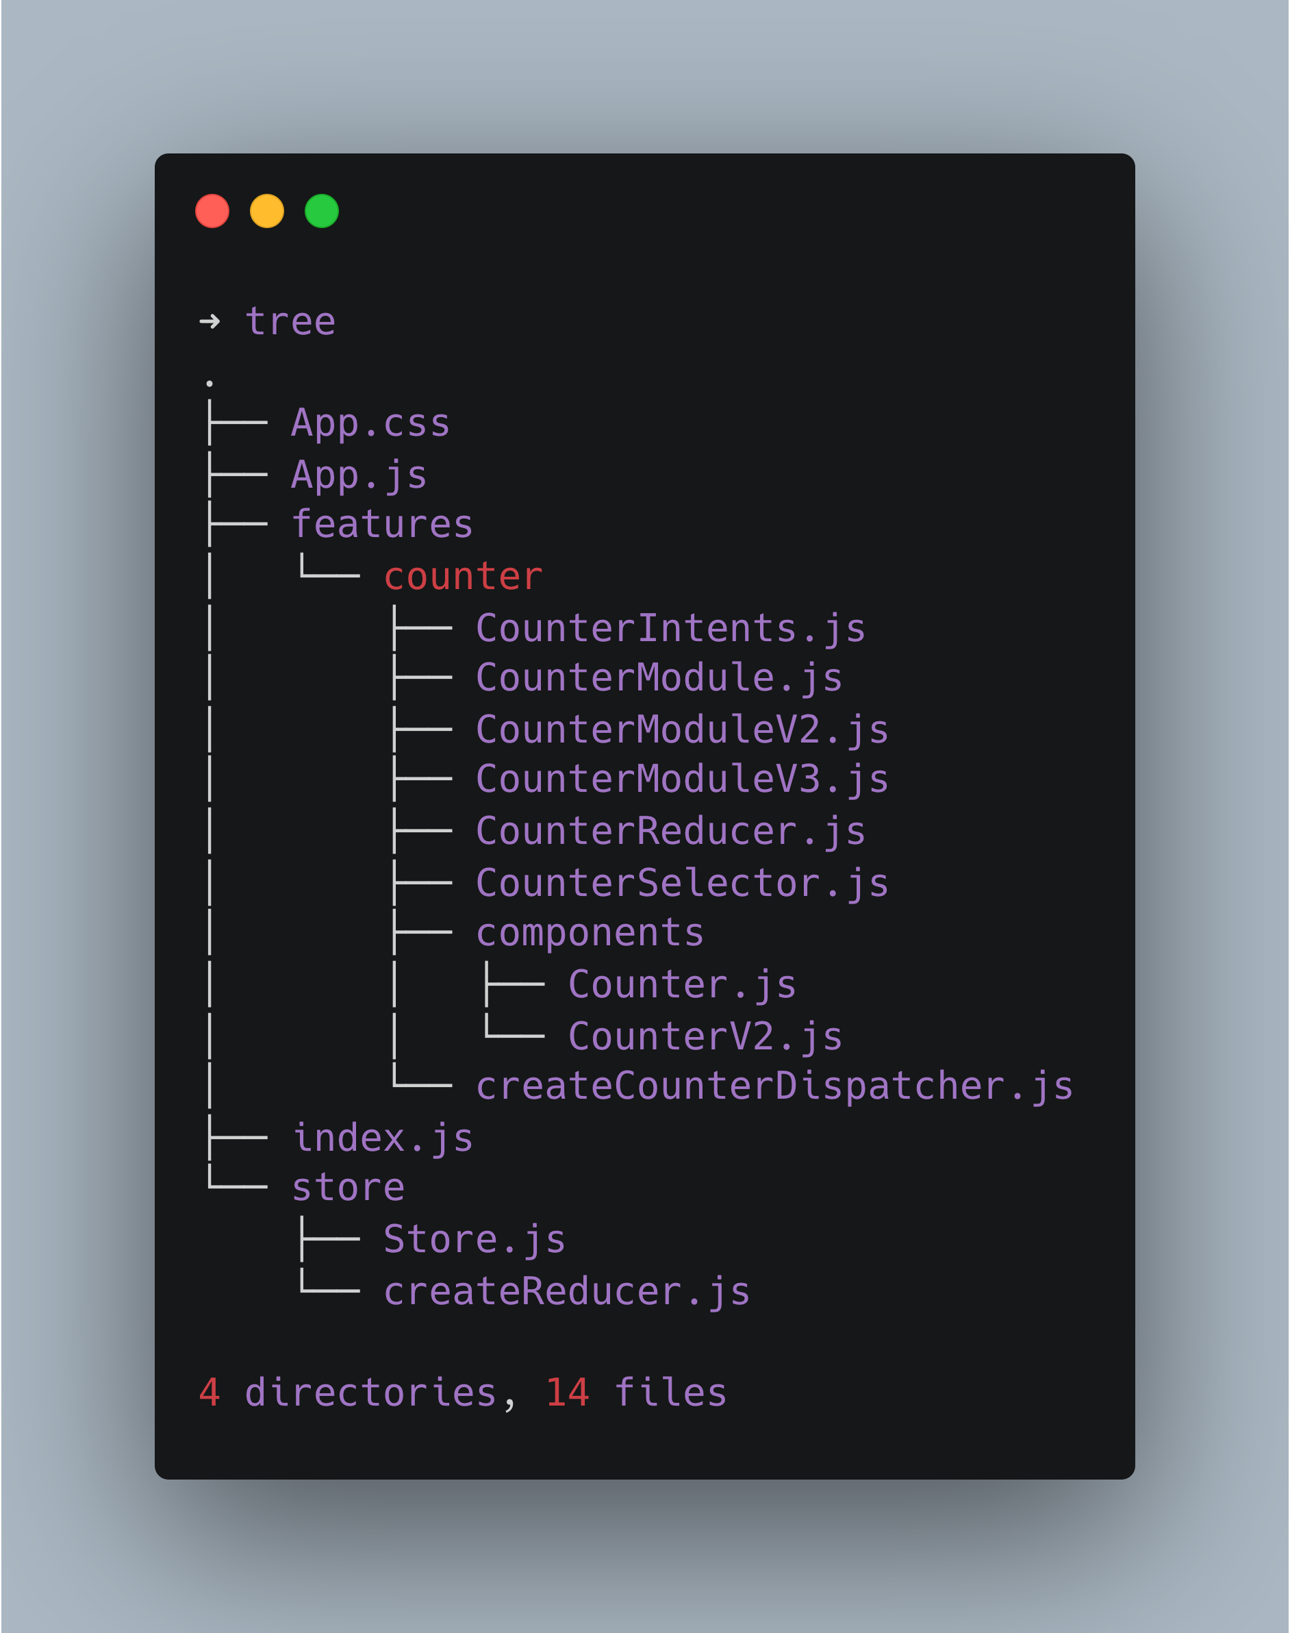

Project Structure(showcase)

Slide 8
Q&A
Do we really need it ?
Not friendly for beginner.
In memory cache state.
Huge of pattern code.
Performance concern.
Maybe it can sample.

Slide 9
References
What Is Redux?
Redux
Redux-in-action
React-basic
what-is-redux-and-what-problem-does-it-solve

Slide 10

Thank you !

